Slide 1
Team ID: r_udokuj
Neeraj Deshpande
Sahil Dorwat
Kunal Kulkarni
Aditya Upadhyay
Git link

Slide 2
Recap
r_udokuj
Project being studied : AngularJS, Bootstrap
Our Goal : Compare the projects based on certain metrics to make an informed choice between the two
Target audience : Students, Project Manager
Primary metrics : Contributions, performance, code analysis, bug severity, support and documentation
Git link

Slide 3
Metrics
r_udokuj
A total of 31 metrics, spread over the following categories:
Contribution statistics
Release cycle/frequency
Bus factor
GitHub statistics (issues, pull requests, etc.)
StackExchange support statistics
Initial cost analysis
Support and Documentation
Bug coverage and severity
Code analysis (complexity, duplication, etc.)
Remediation time
Technical Debt ratio
Git link

Slide 4
Data
r_udokuj
Description | Github link to the data | Explain usage (related to goal)
Survey results | https://github.com/Kunalkul1/Software-Engineering-Project-Fall-2018/blob/master/Survey%20responses.pdf | A survey carried out among students to understand the metrics that drive their decision in choosing the tools.
Forked Bootstrap project for analysis | https://github.com/Kunalkul1/bootstrap | 1st project repo for comparison
Forked AngularJS project for analysis | https://github.com/Kunalkul1/angular.js | 2nd project repo for comparison
GitHub API | https://developer.github.com/v3/ | To collect metrics related to the github
Git link

Slide 5
Findings
r_udokuj
Aspect | Metric & Experiment used | Result | Explanation
Contribution statistics | Number of contributors, Highest contributors, Frequency of commits Experiment - GitHub API | AngularJS - higher contributors Bootstrap - higher commit frequency | AngularJS has more LOC and frequent release cycle than Bootstrap
Bus factor | Bus Factor Experiment - Web Search | AngularJS - 6 Bootstrap - 2 | Higher contributors in AngularJS justify higher bus factor
Bug coverage and severity | Bug coverage, bugs per severity, bugs per component Experiment - CodeClimate | Bootstrap performs better than AngularJS | High contributors, frequent release cycles cause more bugs
StackExchange statistics | Questions (solved and unsolved) on forum Experiment - forum API | AngularJS has more posts on forum than Bootstrap | Higher preference for large-scale projects hence better community support
Git link
*for detailed metric comparison, refer github link

Slide 6
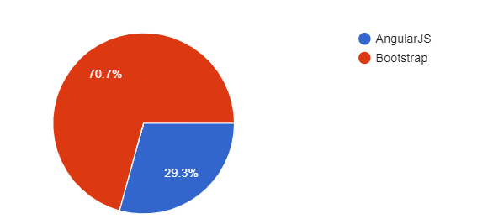
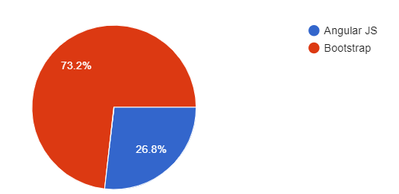
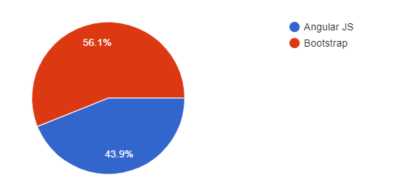
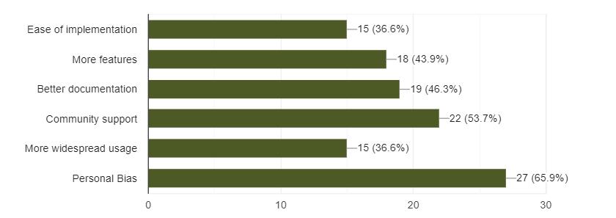
Audience Survey Results
r_udokuj
Ease of Learning
Ease of Usage
Overall Preference
Git link

Slide 7
Analysis Results
r_udokuj
AngularJS: Better in terms of developing larger projects due to better community support and powerful features. Contradictorily, more bug frequency.
Bootstrap: Better in terms of ease of usage, highly flexible and light-weight development.
Contradictorily, only suitable for startups.
Git link

